Slide 1

The Impacts of Holidays on Weekly Sales Patterns
Team member: Thao Nguyen, Chloe Pham, Nam Nguyen, Gracie Nguyen

Slide 2

DATASET OVERVIEW: WALMART SALES FORECASTING
Data from Kaggle covering Feb 2021 - Oct 2012
Merged two files: train.csv (weekly sales) and features.csv (store-level context)
Final dataset: 6,435 records with 9 variables
Includes:
Store, Date, Weekly_Sales, IsHoliday, Temperature,
Fuel_Price, CPI, Unemployment, IsMarkdown (indicates promotional markdowns)
Data joined using an inner join on Store and Date
Notes:
slidesppt.net

Slide 3

RESEARCH OBJECTIVES: IMPACTS OF HOLIDAYS ON WALMART SALES
Main Question:
How do holidays affect weekly sales across Walmart stores?
Purpose:
Understand sales shifts during holiday weeks (e.g., SuperBowl, Labor Day, Thanksgiving, Christmas)
to optimize retail strategies and inform economic insights.
Goals:
1. 📈 Quantify the effect of holidays on sales
2. 📊 Test for statistical significance between holiday vs. non-holiday weeks
3. 🧠 Provide insights for retail planning and decision-making
Notes:
slidesppt.net

Slide 4

TIMES SERIES FORECASTING APPROACH
Sales Forecasting
Sales Forecasting
Sales Forecasting
Sales Forecasting
Data Preprocessing and Quality
Preliminary Findings of Weekly Sales
Autoregressive Model With Monthly Dummies
Recommendations Based on Forecast Results
.
STEP 1
STEP 2
STEP 3
STEP 4

Slide 5

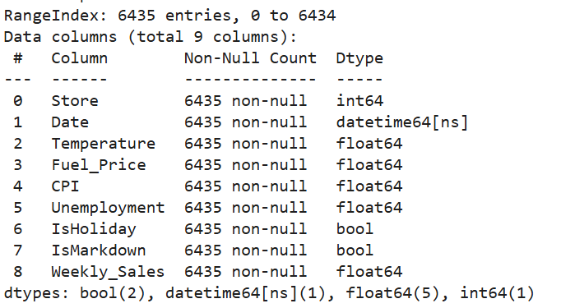
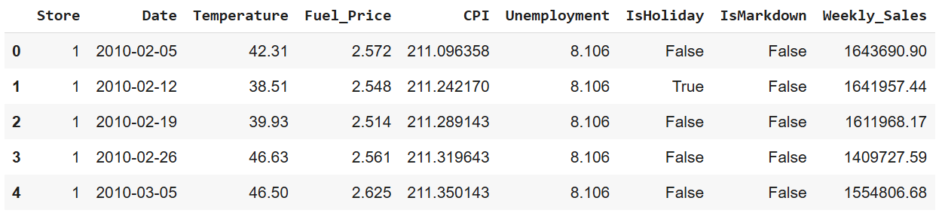
DATA PREPROCESSING & QUALITY CHECKS
Summary of the merged dataset, showing 6,435 records and 9 variables with no missing values in critical columns
We performed data quality checks on two tables, aggregated the data by Store and Date, removed unnecessary columns, handled missing values, created an IsMarkdown variable to simplify markdown fields, ensured no missing values in final key variables, and merged the two datasets for analysis.
Notes:
We conducted data quality checks on two tables, aggregated the data by Store and Date, removed unnecessary columns, and handled missing values. To simplify markdown-related fields, we created an IsMarkdown variable. After ensuring that all key variables were complete, we merged the two datasets to prepare them for analysis.

Slide 6
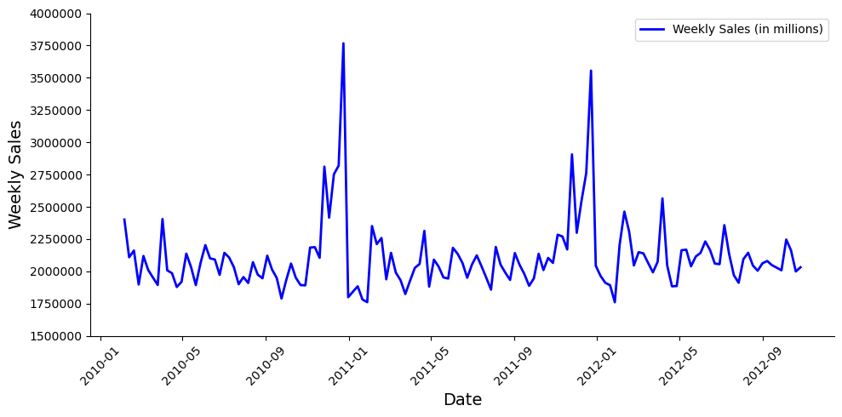
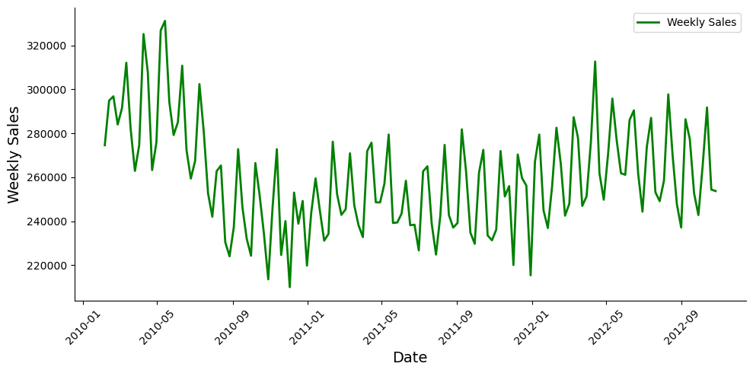
PRELIMINARY FINDINGS
Weekly Sales Over Time - Store 20 (The Highest Sales)
Analyzed merged dataset across 45 stores, we focus on extremes:
Store 20: Highest avg. weekly sales (~$2.1M), showing strong holiday-driven sales spikes, indicating high responsiveness to seasonal demand
Store 33: Lowest avg. weekly sales (~$259K), maintaining stable sales, suggesting limited holiday impact or different customer behavior
Weekly Sales Over Time - Store 33 (The Lowest Sales)
Emphasizes the need to analyze holiday effects and external factors (e.g., IsMarkdown, Temperature, CPI) to better understand variations in sales patterns.
Notes:
slidesppt.net

Slide 7
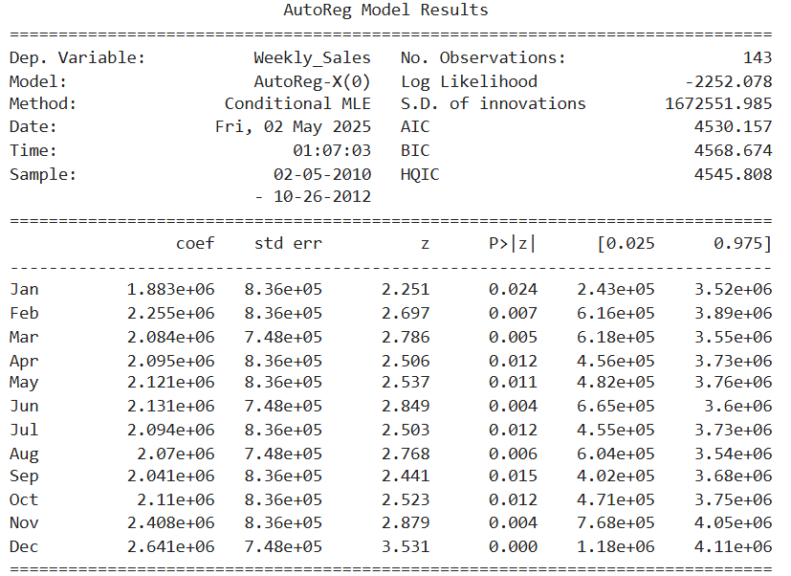
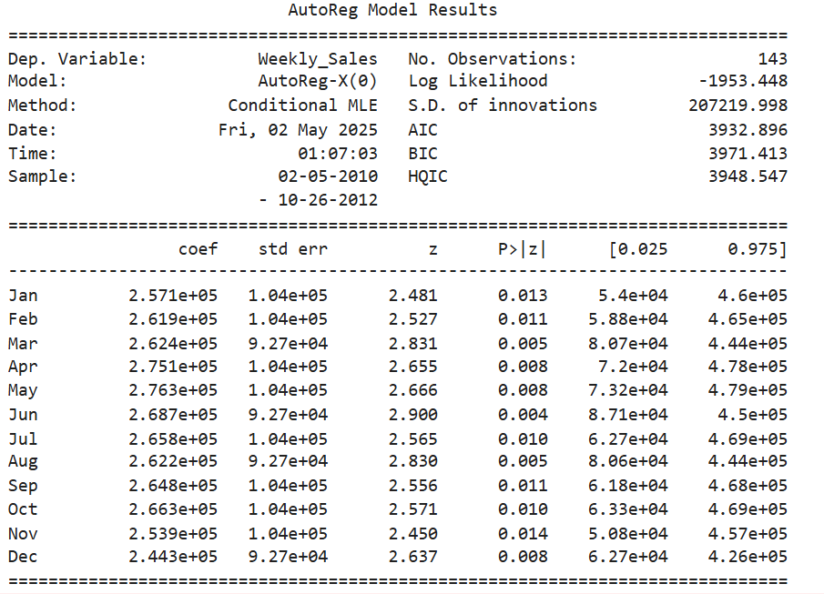
AUTOREGRESSIVE (AR) MODEL WITH MONTHLY DUMMIES
Goal: Identify monthly seasonality in weekly sales for the top-performing and low-performing stores.
Input: Using monthly dummy variables (Jan–Dec) as exogenous features
Model Output:
All months statistically significant ( p < 0.05 ) and coefficients indicate the expected weekly sales value per month
Top Store shows higher magnitude in seasonal effect than the Low Store
Top Store: Monthly Effects on Weekly Sales (AutoReg Model)
Low Store: Monthly Effects on Weekly Sales (AutoReg Model)
Notes:
slidesppt.net

Slide 8
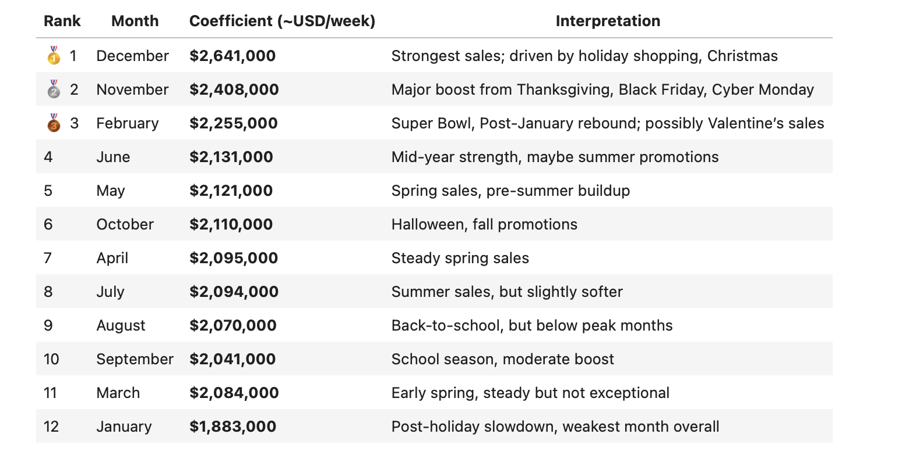
AUTOREGRESSIVE (AR) MODEL WITH MONTHLY DUMMIES
INTERPRETATION
Monthly Sales Impact Breakdown - Top Store
📌 Objective: Rank each month by its estimated contribution to weekly sales using AutoReg model coefficients.
📊 Insights:
🥇 December is the highest-performing month, driven by holiday shopping and Christmas. 🥈 November sees a major boost due to Thanksgiving, Black Friday, and Cyber Monday. 🥉 February likely benefits from Super Bowl, post-January rebound and Valentine's Day. 📉 January is the weakest month, reflecting a post-holiday slowdown. 📈 Sales patterns align with seasonal holidays.
Notes:
slidesppt.net

Slide 9
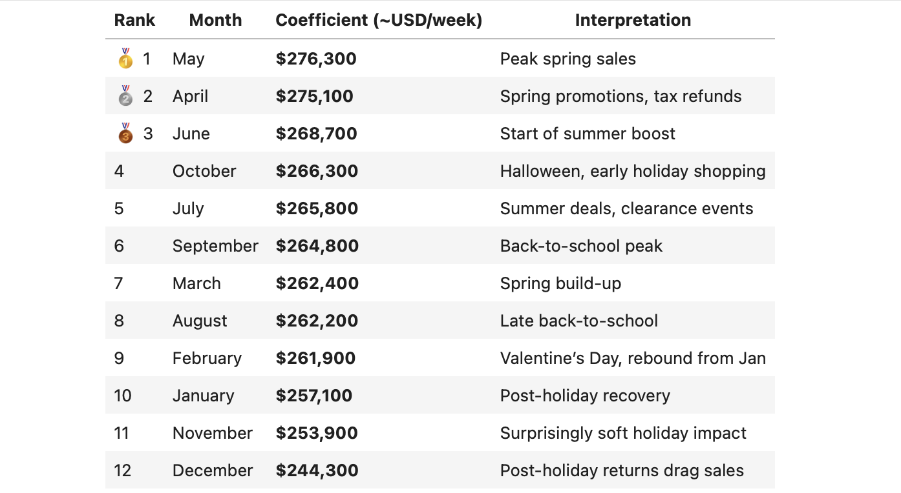
AUTOREGRESSIVE (AR) MODEL WITH MONTHLY DUMMIES
INTERPRETATION
Monthly Sales Impact Breakdown - Low Store
📌 Objective: Rank each month by its estimated contribution to weekly sales using AutoReg model coefficients.
📊 Insights:
🥇 May is the highest-performing month, likely driven by strong spring sales and pre-summer buildup. 🥈 April follows closely, boosted by seasonal promotions and tax return spending. 🥉 June benefits from early summer activity and events like Father’s Day. 📉 December is the lowest-ranked month in this model — potentially due to sales being spread across November and December, or modeling capturing post-holiday returns. 📈 Sales patterns do not strongly follow typical holiday or seasonal cycles — months like November and December underperform despite major holidays, suggesting possible missing data, store-specific factors, or non-holiday-driven trends.
Notes:
slidesppt.net

Slide 10
STRATEGIC RECOMMENDATIONS
🛍️ Maximize Holiday Performance (Nov–Dec):
Increase inventory and staffing in top stores ahead of Black Friday and Christmas. Launch early promotions and exclusive holiday bundles to extend the shopping window. Invest in online order capacity and logistics during this peak season.
💘 Capitalize on Smaller Seasonal Peaks (Feb, May, Mar):
Promote Valentine’s Day, spring sales, and Mother’s Day campaigns to drive traffic. Use targeted marketing for gift categories, apparel, and seasonal home goods.
📉 Boost January Sales:
Introduce New Year promotions, fitness/wellness product discounts, or loyalty rewards to combat the post-holiday slump. Consider inventory clearance events to start the year with leaner stock.
D
E
A
F
C
B
G
🏪 Tailor Strategy by Store Type:
Top-performing stores benefit from dynamic seasonal strategies — maintain aggressive promotion calendars. Lower-performing stores show steadier patterns — optimize cost-efficiency and focus on predictable categories like groceries and essentials.
Notes:
slidesppt.net

Slide 11
For the next step, we would like to…
🔄 Extend the AutoReg model by applying it to other stores or the test.csv dataset to assess its generalizability.
📈 Generate forecasts for future weekly sales, helping to identify trends and potential high/low performing periods.
📊 Evaluate model performance by comparing predictions with actual data , and adjust for store-specific patterns.
🔍 Explore additional variables (e.g., promotions, holidays, regional effects) to improve model accuracy and interpretability.
💡 Or any recommendations?
Next Step…
Notes:
slidesppt.net

Slide 12
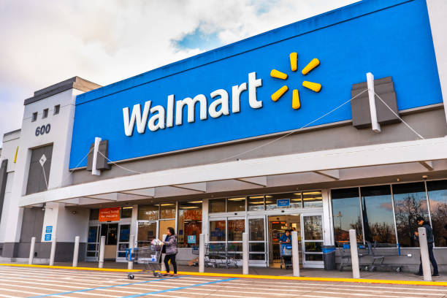
THANKS!
Does anyone have any questions?

